Slide 1
University App 🎓
Prepared by Ihor Melashchenko (C00290950), Software Development, Year 4
Notes:
Good morning!
My name is Ihor Melashchenko, and I am a final-year Software Development student at SETU.
Today, I will be presenting my final-year project — the University App (please note that the name is not yet finalized and might change in the future).
It started as a simple idea — which I’ll reveal in a moment — back when I was in my second year.
However, it quickly evolved into something much bigger: a platform designed to connect every part of student life — from academic information to campus services — all in one place.

Slide 2




💔 Current Problems
Fragmented systems
Multiple logins
Limited integration between systems
Notes:
So, let’s look at the current problems that exist within the university.
First, we have fragmented systems. Currently, students are faced with multiple disconnected tools: Blackboard on the Carlow campus, Moodle on the Waterford campus, an outdated proprietary website for timetables, and a separate app for accessing printing services.
These fragmented systems make it hard to engage effectively with university services.
Second, there are multiple logins — each system requires a different way of accessing it and a different interface.
Finally, there’s limited integration between systems. They have little to no integration with each other, creating inconvenience for both students and staff.

Slide 3
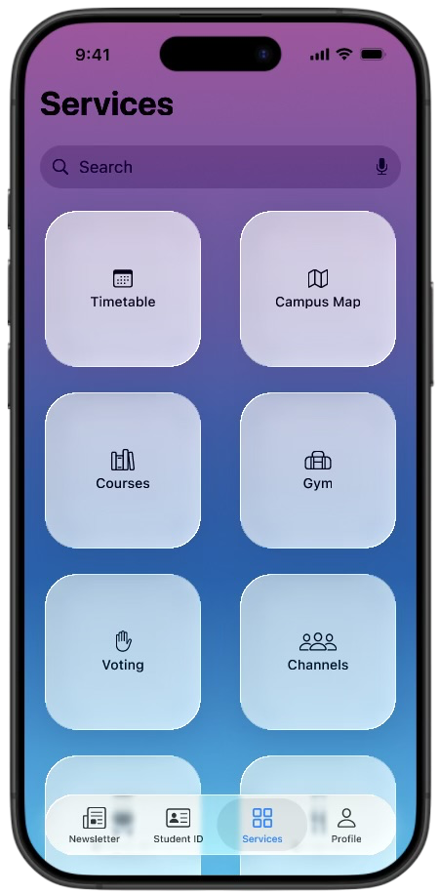
💡 Solution
“One App. One Login. One Student Experience.”
Notes:
So, how can we solve these problems?
I came up with the next motto: “One App. One Login. One Student Experience.”
To explore the concept further, I surveyed students, conducted research, and developed a prototype.
The initial implementation of the University App will be available on iPhones.
Each version — iOS, Android, and Web — will be built natively to ensure the best possible user experience.
This approach requires using different technologies for each platform, but it guarantees performance and reliability.

Slide 4




✨ Core Features
Interactive Timetable
Assignment Tracker
Campus Map
Profile & Personalization
And More…
Notes:
Let’s take a look at the core features of the University App.
First, an interactive timetable that helps students track their classes and avoid missing lectures.
Second, an assignment tracker — using which, students will never miss a deadline.
Third, a campus map, which will be particularly useful for the first-year students.
Next, customizable profiles and elements of gamification, encouraging engagement and motivation.
Please note that this list is not yet finalized, and features may evolve as development continues.

Slide 5
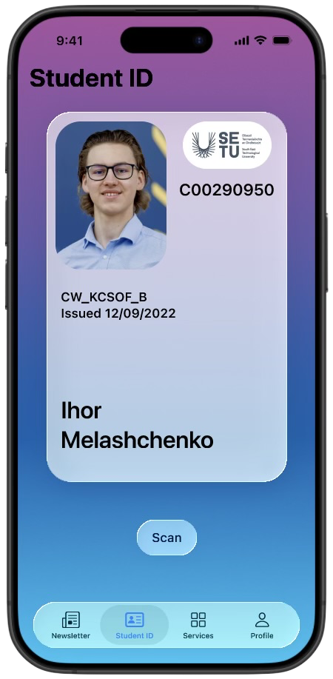
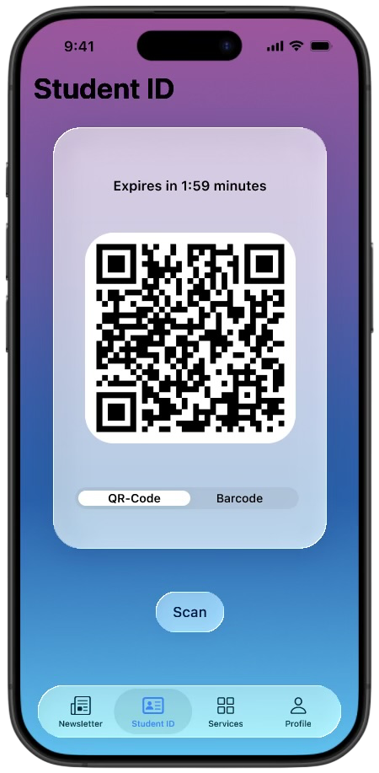
🤯 One More Thing…
Digital Student ID
Notes:
You might be thinking that the app, as described so far, is useful but not yet truly innovative.
So, let me introduce the main and most exciting feature — the Digital Student ID.
This feature is comprehensive, so I will only highlight the key points:
1. The ID uses a time-limited QR code or barcode that can be scanned for verification — for example, when entering the library or accessing on-campus services.
Students can also verify each other’s IDs directly within the app.
2. It provides a secure and sustainable alternative to plastic cards.
3. This feature is what inspired the entire project, representing both innovation and practicality in a modern university setting.

Slide 6

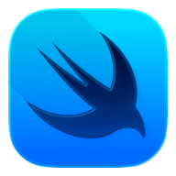



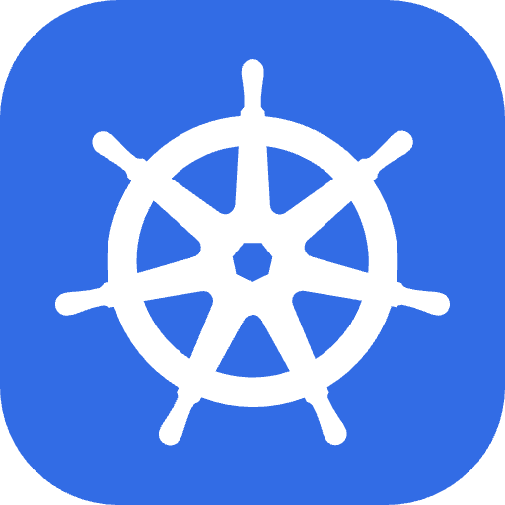
🛠️ Architecture & Technologies
Notes:
From the technical perspective, the app will be developed in Swift using the SwiftUI framework.
The backend will be written in Go, exposing RESTful APIs that the mobile and web apps will access.
Data will be securely stored in a PostgreSQL database.
The backend will run in Docker containers orchestrated with Kubernetes for scalability.
The architecture is designed to be future-proof, enabling easy expansion to Android and Web versions.
Please note that the technology stack is not fixed and may evolve as the project progresses.

Slide 7
🙏 Thank You!
Any Questions? 🤔
Notes:
Thank you for your attention!
My vision for the future is to expand the University App to include more campus services — such as gym access, a student voting system, and deeper integration with on-campus services.
The app also has the potential to be adopted by other higher-education institutions in Ireland and beyond.
I’d be happy to answer any questions or hear your feedback.

